Slide 1


Perspectives on Saudi Arabia Manufacturing!
Serhan Alshammari
17th March, 2015

Slide 2
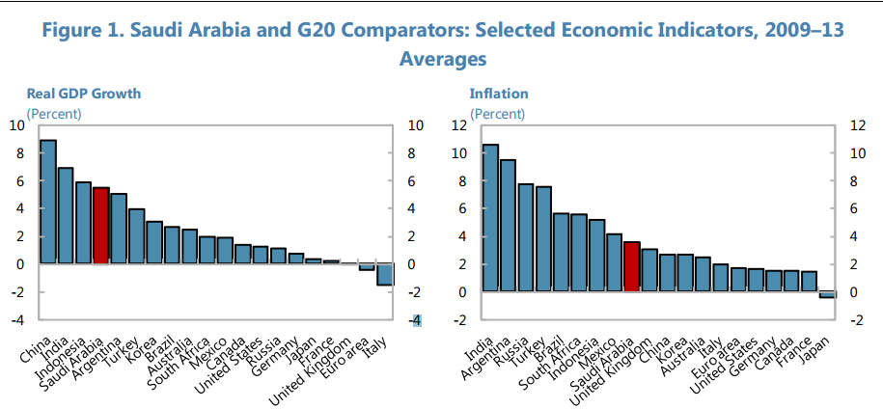
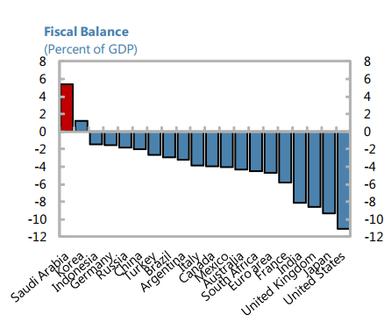
Economical indicators
http://www.imf.org/

Slide 3
Economical indicators
Growth in GDP-Nominal (%) 6.2
http://www.mep.gov.sa

Slide 4
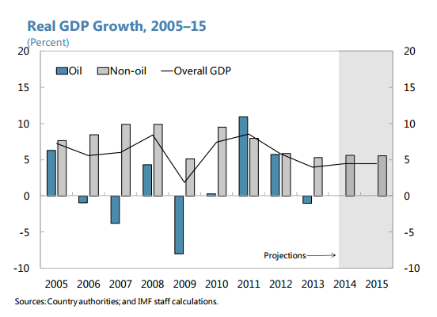
Economical indicators
http://www.imf.org/

Slide 5
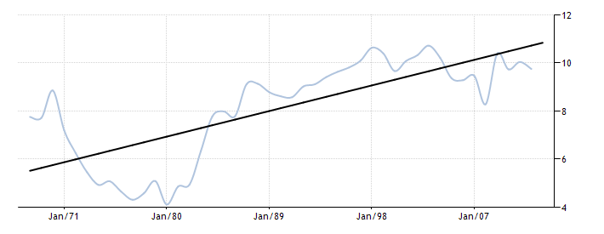
Economical indicators
Manufacturing - value added (% of GDP) in Saudi Arabia
1967 -2015
1970 – 2019 MEP 20% 2020
http://www.worldbank.org/

Slide 6
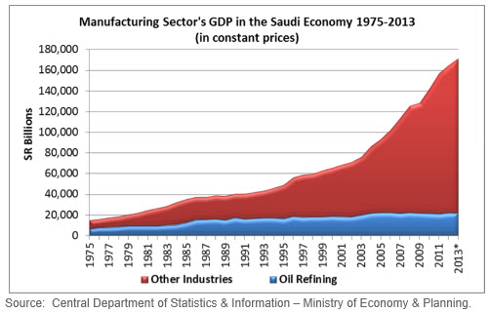
Manufacturing indicators
http://www.sidf.gov.sa/

Slide 7
Industrial diversity (ISIC) , $ 500 Billion
http://mci.gov.sa/

Slide 8
Industrial cities:
32 cities
3000 factories
300,000 employees.
$250 B
http://www.modon.gov.sa/

Slide 9
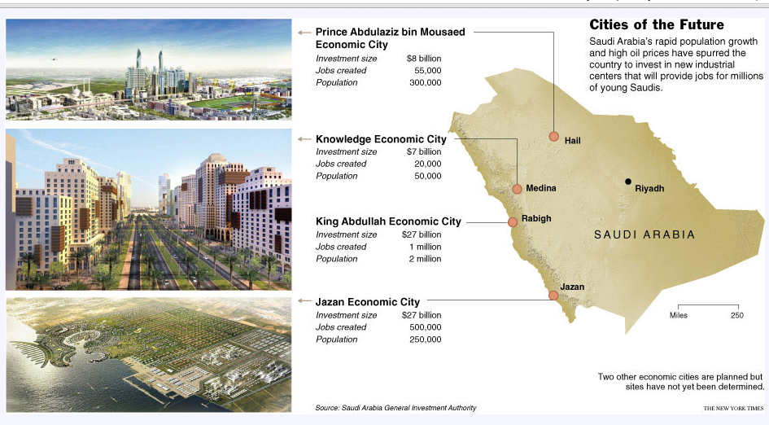
Economical Cities
http://www.sagia.gov.sa/en/SAGIA/Media-centre/Interactive-map1/

Slide 10
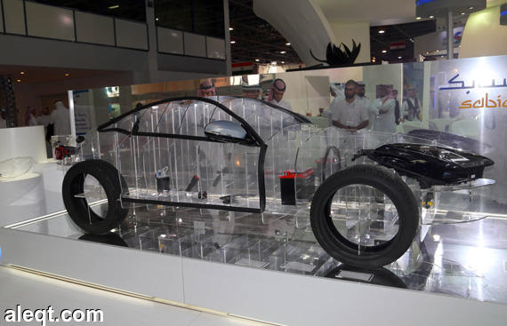

Petrochemicals and plastic industries
About 100 million Tons annually, with only 2 million tons of down stream product.
Annual growth rate 8%
Current investments 50 billion USD 91 billion USD, in 10 years.
www.saudi-pppp.com

Slide 11
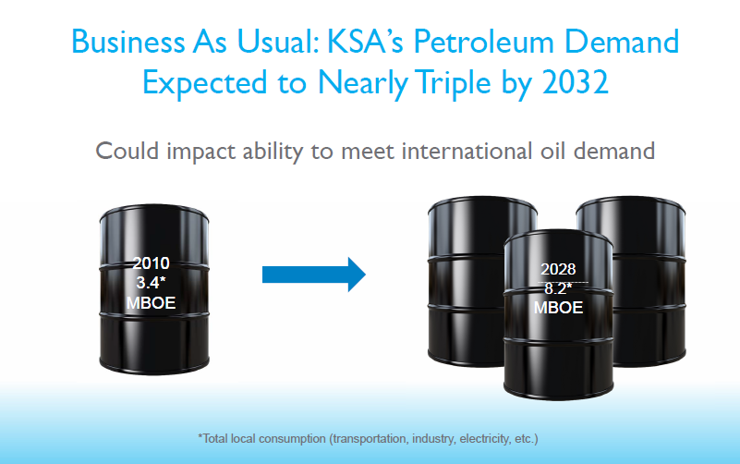
Energy opportunities
http://www.saudisustainablesymposium.com/

Slide 12
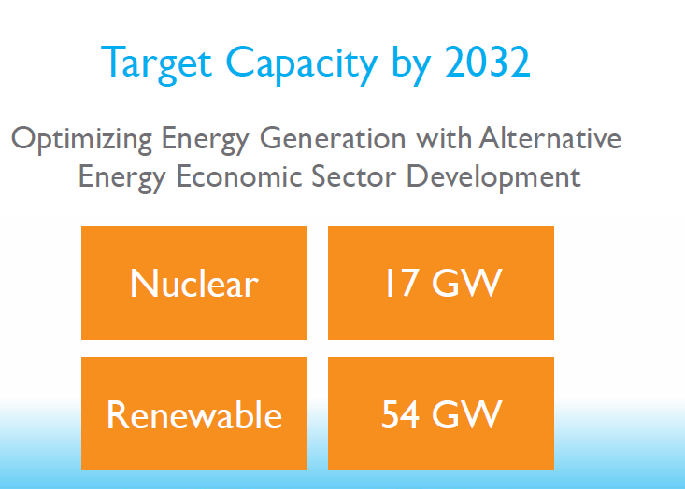
Energy opportunities
http://www.saudisustainablesymposium.com/

Slide 13
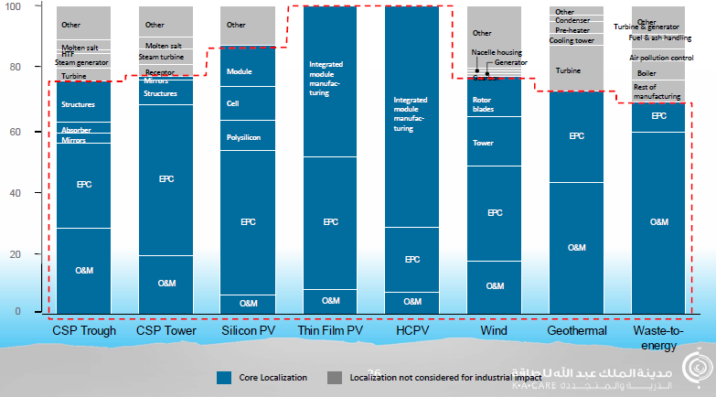
Energy opportunities

Slide 14
Challenges
Keeping pace with Developments in International Markets
Expediting Transfer and Adoption of Technology
Development of local manpower capabilities
  Abroad Scholarship program ( 250000 ) in 10 years.
  universities capacities and counts increased by 5 times in 8 years.
Factory-building may not be the best way to diversify the economy ( the economist, 2015)
http://www.sidf.gov.sa/

Slide 15
Thank you

