Slide 1
Manufacturing and Industrial Evolution – the future
from someone who likes factories, likes people, likes the planet, thinks about the future & loves a good argument
Steve Evans
Director, Centre for Industrial Sustainability, Institute for Manufacturing, University of Cambridge
Co-Founder, Riversimple
se321@cam.ac.uk

Slide 2
Let’s start with some trends

Slide 3
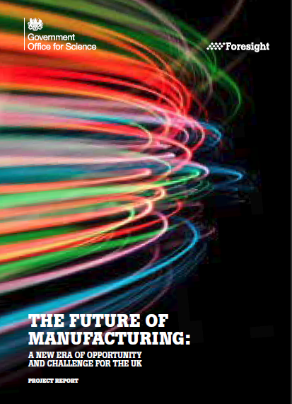
The Future of Manufacturing: A new era of opportunity and challenge

Slide 4
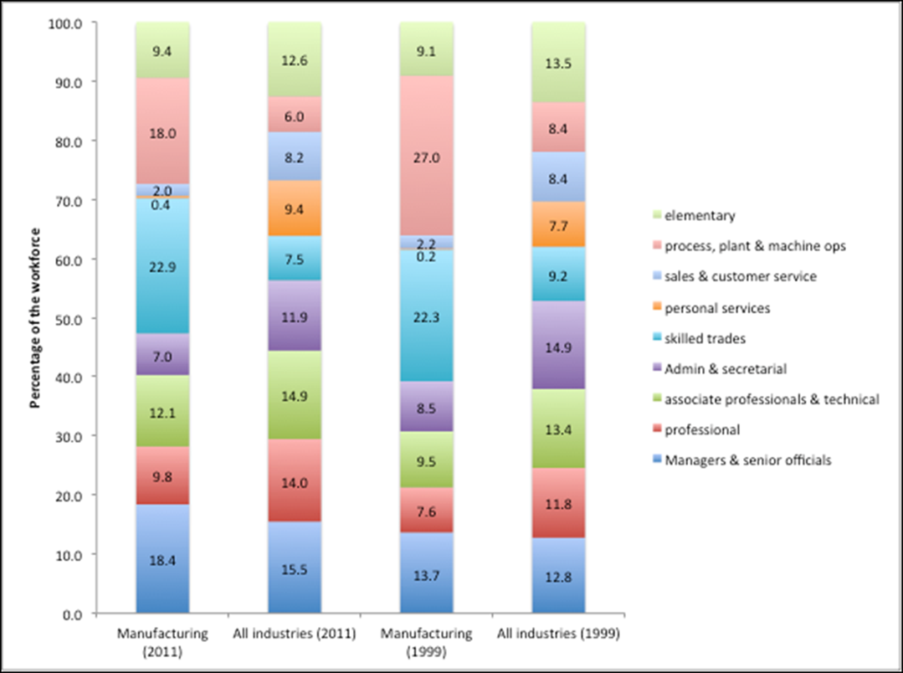
UK manufacturing 2011: 18% of staff are operators
18.4% are managers

Slide 5
Growth will be jobless

Slide 6
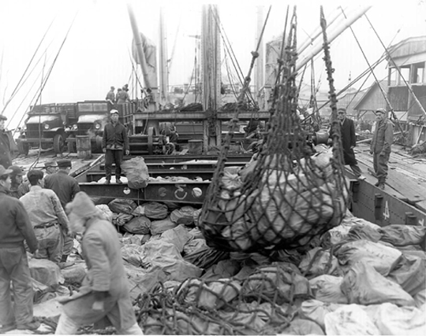
Technology & Politics

Slide 7
By 2050 we will see a technological revolution in how products are designed, offered and used by customers.
New opportunities for value creation
Massive Incremental Technology
Full integration of ICT digital modelling, simulation and automation
Massive Incremental Technology
Sensors integrated into digital networks and products
Radical Technology
Bio and medical technology
Radical Technology
Additive manufacturing becomes mainstream
Disruptive Technology
disruptive and innovative technologies
Massive Incremental Technology
New materials
Massive Incremental Technology
Sustainable technologies
More consumers
more urban & connected
digitalization
constrained resources disruptions
servitization
big data
small factories
7

Slide 8
Growth in value not GDP

Slide 9
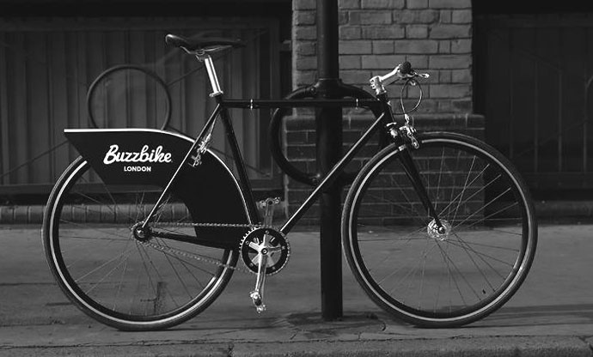
What is value?
Free mobility

Slide 10
Science Fiction vs Useful Imagining
Take a single dimension of change
Move it to the extreme
Calculate the obvious implications and then the less-obvious implications…
Keep going!

Slide 11
Disrupted availability of raw materials
One imagining only

Slide 12
Disrupted availability of raw materials
Need to avoid crisis minerals
Desire to reduce imports for resilience
Circular economy thinking
Customers seek provenance
Massive push for resource efficiency
One imagining only

Slide 13
Disrupted availability of raw materials
Need to avoid crisis minerals
Desire to reduce imports for resilience
Circular economy thinking
Customers seek provenance
Massive push for resource efficiency
?
Unwilling to share materials
High taxes on materials Low taxes on work
New production processes
- small scale
- re-configurable
- accessing global knowledge
One imagining only

Slide 14
Disrupted availability of raw materials
Need to avoid crisis minerals
Desire to reduce imports for resilience
Circular economy thinking
Customers seek provenance
Massive push for resource efficiency
?
Unwilling to share materials
High taxes on materials Low taxes on work
New production processes
- small scale
- re-configurable
- accessing global knowledge
FORAGING FACTORY
Is aware of locally available materials
Can adjust production to make locally useful things
Can extract value from natural and mineral materials
Is supported by global knowledge flows
One imagining only

Slide 15
Science Fiction vs Useful Imagining
Take a single dimension of change
Move it to the extreme
Calculate the obvious implications and then the less-obvious implications…
Keep going!
Then add another dimension (if you can handle it with your feeble human brain)

Slide 16
Business as usual, focus on efficiency, hoping for a growing market
Location decisions change
Strong focus on efficiency
Increased information content (either free or paid for)
Sensors in everything
Increased provenance
Automation everywhere
Personalisation
Co-creation
Gentani (actual limits)
Business Leadership
Well-being as business goal
Disruption, experimentation, radical technology
Multiple disruptions food-water-energy politics
Scale logic changes direction Resilience to disruptions (s/c’s)
Search for value chemistry product business model Big data sensors for life seeing everything
Circular economy Information replaces materials Lightweight, complex materials
Bio-materials
Experiments everywhere
New structures & governance
Sustainable making Commons New models of growth
Manufacturing supply chain flattens with a new geography local making PositiveFactory retail making
Enabling product architectures
New forms of governance Base of pyramid fully engaged
Business Leadership++
Key Influences to 2050

Slide 17
Some big trends
More biology, less physics
Understand & retain value
Retail robot – with hugs
Scale logic changes
Global knowledge with local making
New governance

Slide 18
War Famine Pestilence Death

Slide 19
I am a technological optimist

Slide 20
Which trend first?
…..
And what happens to that when this one arrives?
….
And a final complication?
…..
Manufacturing 2076?

Slide 21
What if we taxed bad things only?
Labour & Knowledge would replace materials
What if?
….
and?
…..
Manufacturing 2076?

Slide 22
What if we taxed bad things only?
Labour & Knowledge would replace materials
What if everyone held their DNA (& other) data?
….
and?
…..
Manufacturing 2076?

Slide 23
What if we taxed bad things only?
Labour & Knowledge would replace materials
What if everyone held their DNA (& other) data?
….
and last mile logistics is free?
…..
Manufacturing 2076?

Slide 24
4x value
2x days work
0.5x material
0.0x CO2

