Slide 1
Humans out of the loop: Cyber defence in 2075.
Professor Paul THERON, PhD
Atkins-Cranfield chair of cyber resilience
Head of Manufacturing Informatics Centre
Manufacturing 2075 conference, Cranfield, 2018

Slide 2
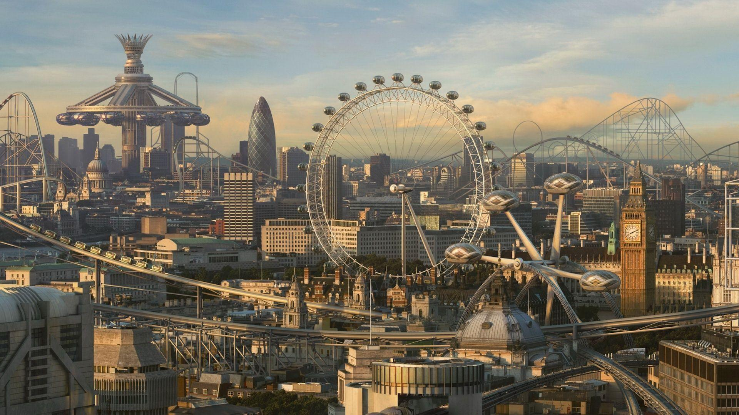

Credit: https://wallpapercave.com

Slide 3

Credit: https://wallpapercave.com

Slide 4

Credit: Shutterstock

Slide 5
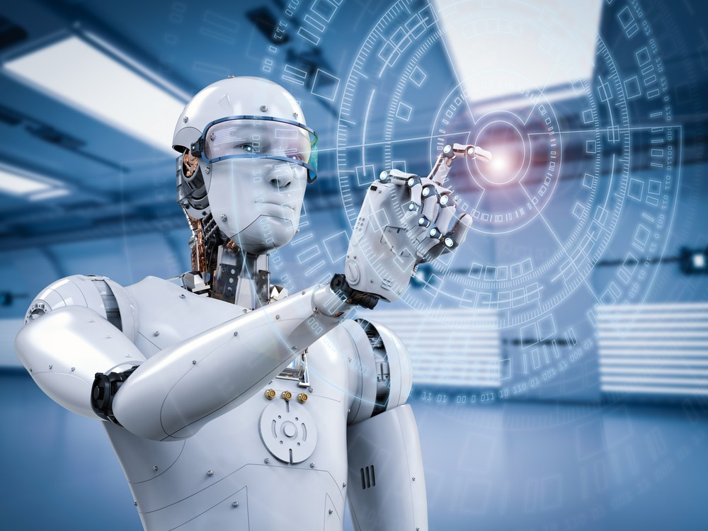
Credit: https://i0.wp.com

Slide 6
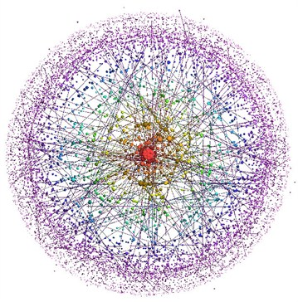
Our future…

Slide 7

Anything that mankind imagine will happen
Ancient Greece
  Premises of the submarine
2nd C ad: Lucian of Samosata
  A true story: Voyage to the Moon
15th C ad: Leonardo da Vinci
  Tank
  Helicopter
1860 & 1865: Jules Verne
  20th Century Paris & flying buses
  From the Earth to the Moon
1901: H.G. Wells
  Anticipations & the Mechanical revolution
  1984 : Big Brother…
21st Century
  Goodware against Malware
  Autonomous cyber-battles
PHILAE robot on comet CHOURY, 1st image, 13 November 2014
Samosata, L. d., 2nd Century. A true story. Anatoly
Wells, H. G., 1901. Anticipations of the Reaction of Mechanical and Scientific Progress upon Human Life and Thought. London, UK: Chapman & Hall.

Slide 8
Research question
How shall we cyber-defend those future autonomous and very complex systems?
Cyber defence must be made
  By default
  By design
  For life
  Affordable
  Pervasive
  Seamless
    To assure the trust in and liking of future technology
      In order to make tomorrow’s world both safe and comfortable

Slide 9

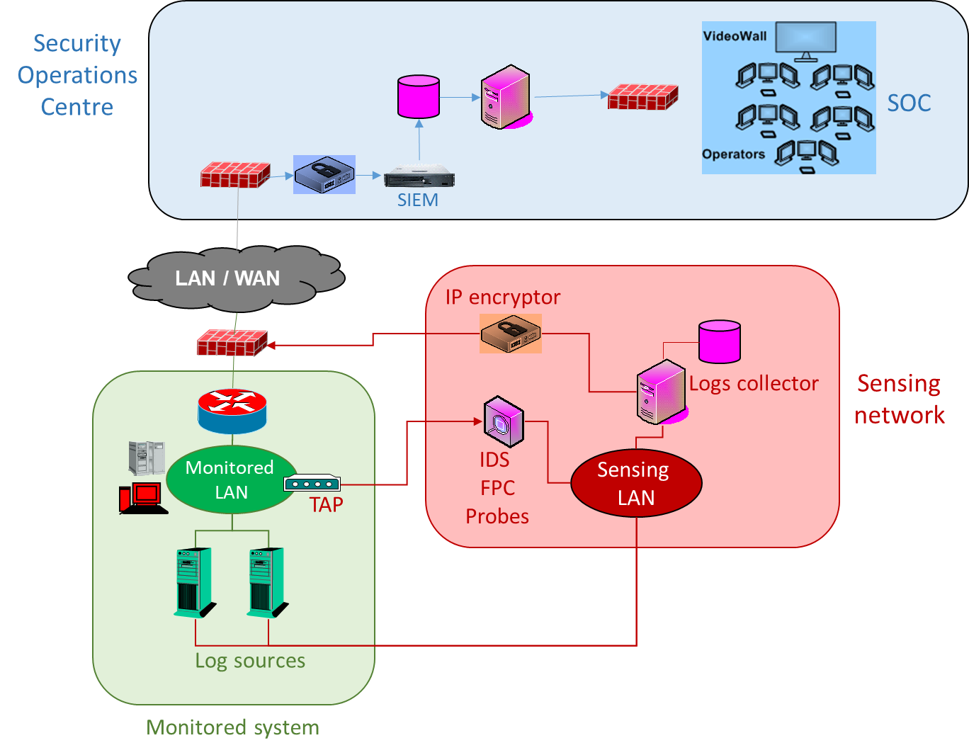
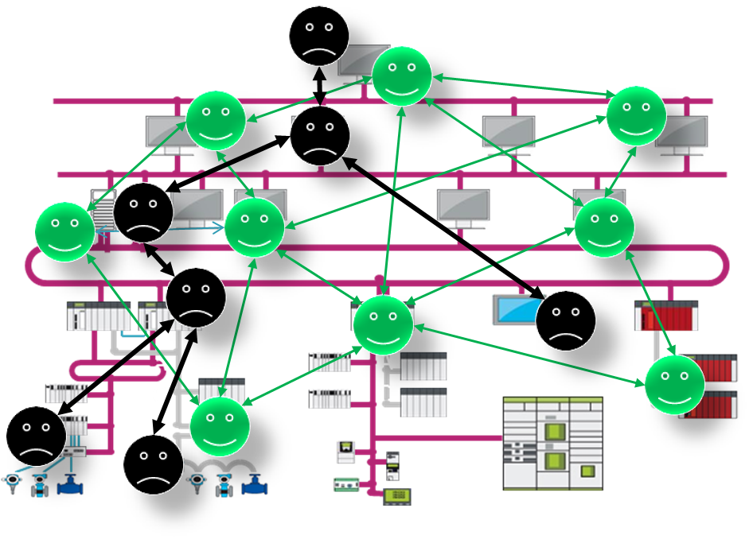
Making cyber defence autonomous means a paradigm shift
Monitoring
Detection & Confirmation
Response planning
Plan execution & tactics
Reporting

Slide 10
Reference Architecture
Autonomous cyber defence
Autonomous Individual Decision
Collective Intelligence
Autonomous Engineering
Technologies, Implementation & Compatibility
Stealth & Resilience
Friend or Foe?, Ping, Trust and Dynamics
Engineering & Certification
Cyber-attack Modelling & Formal graphs
Learning, Loading, Sizing
Cooperation with external entities
At-scale Simulation
12 research challenges

Slide 11
In conclusion
A major endeavour
  12 research challenges
  10-year horizon
Origin
  NATO IST 152
  Cyb’Air research chair
1st NATO-Industry workshop 19/03/19
  https://www.cranfield.ac.uk/events/events-2019/1st-nato-indsutry-workshop-on-autonomous-cyber-defence
ACyD Research & Innovation cluster
  A working prototype in 3 years from now

Slide 12
Thank you for your attention.
Email: p.theron@cranfield.ac.uk
Phone: 01234 75 4955

