Slide 1
The good carbon
Circular approach to curbing GHG emissions in transportation industry for a sustainable future
Cranfield Manufacturing 2075 conference
Benoit GAUTHIER
06 December 2017
Notes:
PROBLEM:
We are getting late at emissions cutting across the board of sectors, including transportation
Aerospace should lead the way.
What path to take in front of such multiplication, fragmentation of electricity generation so as to ensure proper green mobility end-to-end.
BENEFITS:
Apart from avoiding getting beyond the 2°C mark, with its dramatic tail of events,
Lower the barriers of adoption and accelerate the future of mobility for mankind, on earth and beyond, generating business opportunitites and sustainable growth
SOLUTION:
Have a multi-circular approach to the problem, looking at new sustainable loops involving carbon and hydrogen cycles, in addition to electrolysis, thanks to plasma-cracking of methane or CO2, generating high value carbon (e.g. graphene) that can be used in multiple industries as an efficiency agent,
Avoiding stranded assets until full electric generation comes from renewables
Revaluating uses of CCS efforts and organic waste.
From the Good, the Bad and the Ugly carbon to the Smart Carbon.
CALL TO ACTION:
Join the Smart Carbon Alliance and help bring it close to Hydrogen Forum so as to propose actual joint remediation actions
Spread the word, challenge the idea, help define, coordinate and focus actions to save the planet.
While enabling new sustainable, smart and circular business models for the post-climate crisis era. This is Earth 2.0.

Slide 2
Disclaimer
The views expressed in this presentation do not necessarily reflect the views or positions of Airbus. The presentation does not constitute advice on any specific issue or situation. Airbus makes no representation or warranty, express or implied, in respect of the presentation’s content (including its completeness or accuracy) and shall not be responsible for any use of, or reliance on, the paper. Comments are welcome, directed to benoit.gauthier@airbus.com.

Slide 3

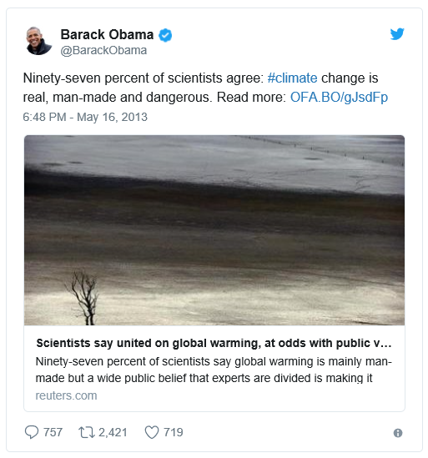
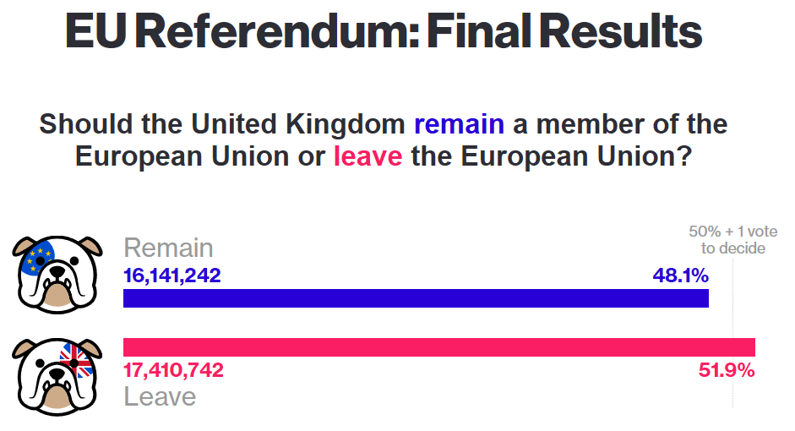
Is climate change still up for debate?
Either evidence-based and science driven or via democracy, let’s consider we are facing a planetary state of emergency

Slide 4
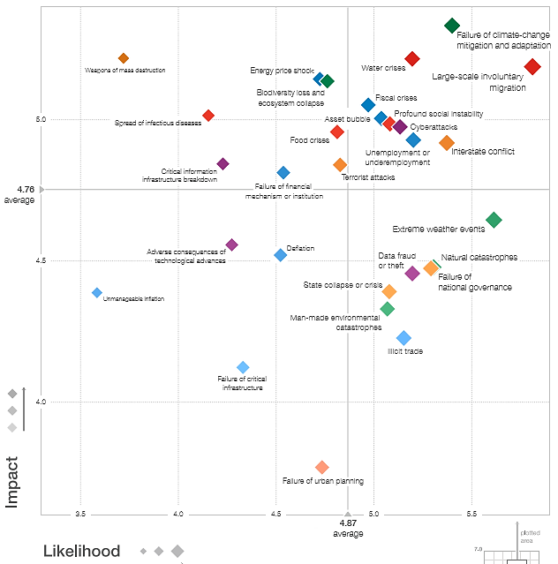

Main risks for society
Failure of climate change mitigation & adaptation is N°1 disruption risk to society
Source: World Economic Forum, The Global Risks Report 2016

Slide 5
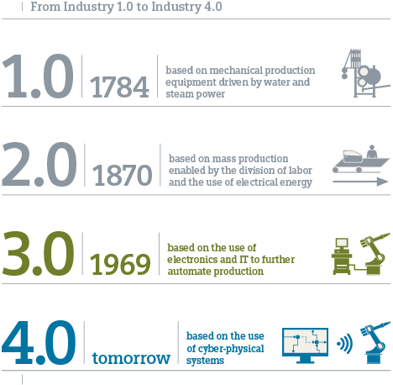
The « good » carbon, energizing the 2 first Industrial Revolutions
Coal
Oil, gas
Global Climate challenge solved
Bad Carbon?

Slide 6
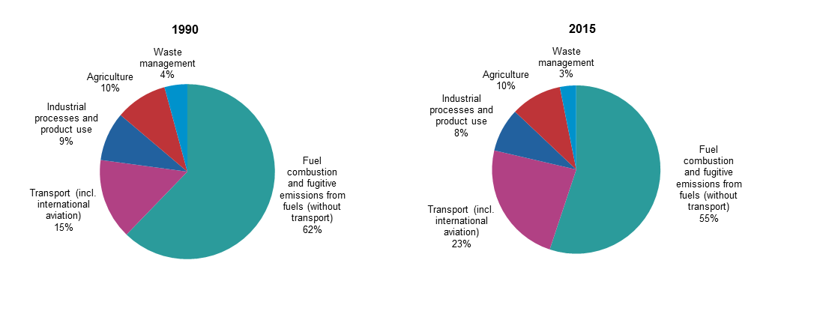

The transportation sector emissions contribution on the rise
Source: Eurostat - http://ec.europa.eu/eurostat/statistics-explained/index.php/File:Greenhouse_gas_emissions,_analysis_by_source_sector,_EU-28,_1990_and_2015_(percentage_of_total)_new.png
Aviation is responsible for 2% of anthropogenic CO2 emissions” (IPCC AR5)
However, much higher impact linked to cirrus contrails
Aviation GHG is poised to increase to 15% of global emissions by 2050 (IEA 450ppm scenario)

Slide 7
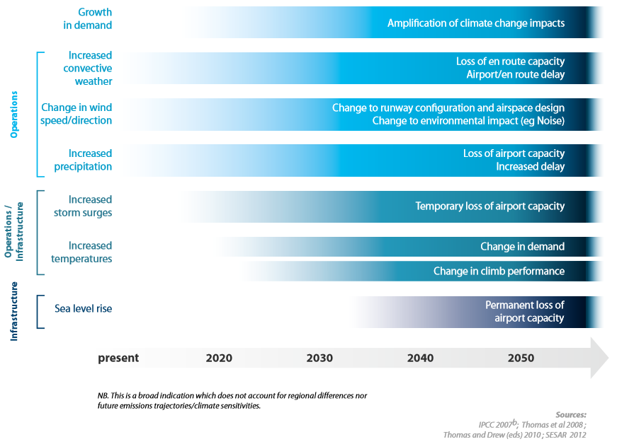
Climate change increasingly affects aviation
Flight cancellations due to high temperatures
Airport exposures to sea level rise
Vulnerability to extreme storms
Increasing risk of CO2-increased turbulence
Probable consequences on other sectors

Slide 8
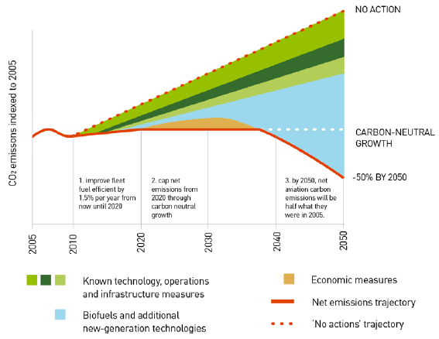
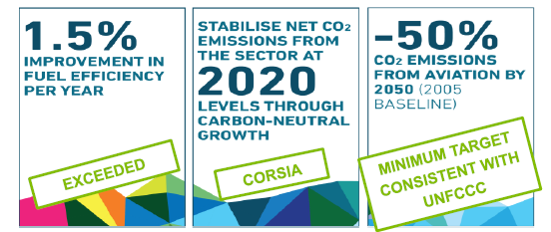
Aviation industry set ambitious CO₂ emission reduction targets
Good trends …
But policies (e.g. COP21 are getting more stringent)…
…But Still pending

Slide 9


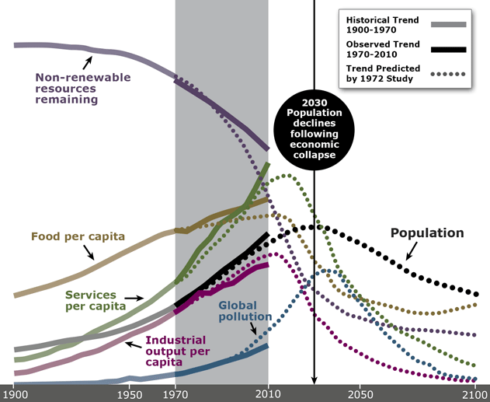
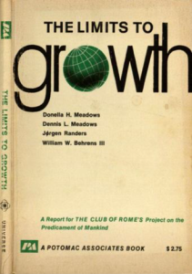
The limits to growth
Convergence on
tipping point
1972
The « Probematique »: a network of interconnected challenges w/ feedback loops
Notes:
We cannot take the chance to destroy our own home!
Or we need more “space”
Current worldwide trends are not sustainable. The Club of Rome’s warnings published in the book Limits to Growth are still valid.
Remedies that are acceptable for the great majority tend to make things worse. We seem to be in a philosophical crisis. Pope Francis says it clearly: our common home is in deadly danger. Analyzing the philosophical crisis, the book comes to the conclusion that the world may need a “new enlightenment”; one that is not based solely on doctrine, but instead addresses a balance between humans and nature, as well as a balance between markets and the state, and the short versus long term. To do this we need to leave behind working in ”silos” in favor of a more systemic approach that will require us to rethink the organization of science and education.

Slide 10
Towards electrification of aviation
How is key

Slide 11
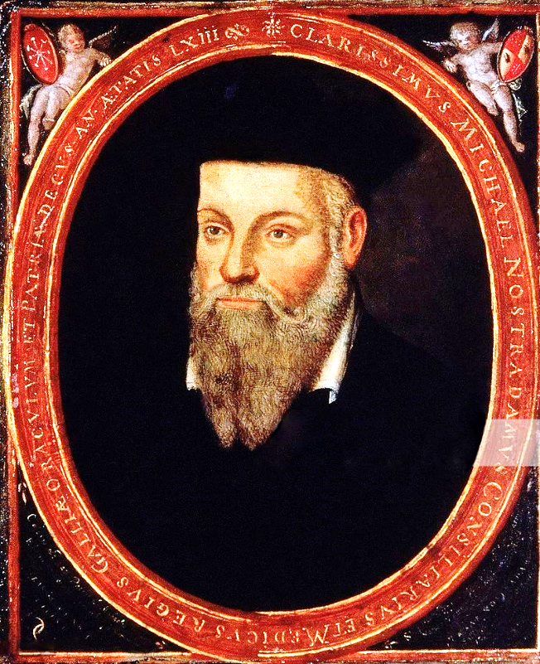

Electric transportation, futurology or reality?
In fact, not here nor able to predict the future
The only ones authorized to do that at Airbus are the Global Market Forecast guys
(they’ve even released an App!)
Nostradamus, 16th century
→ Let’s project ourselves in a mobility-driven future path
Notes:
Although forecasting is key for long-cycle businesses such as Aerospace, I don’t pretend to predict the future.
However, I would like to reflect on existing scenarios

Slide 12
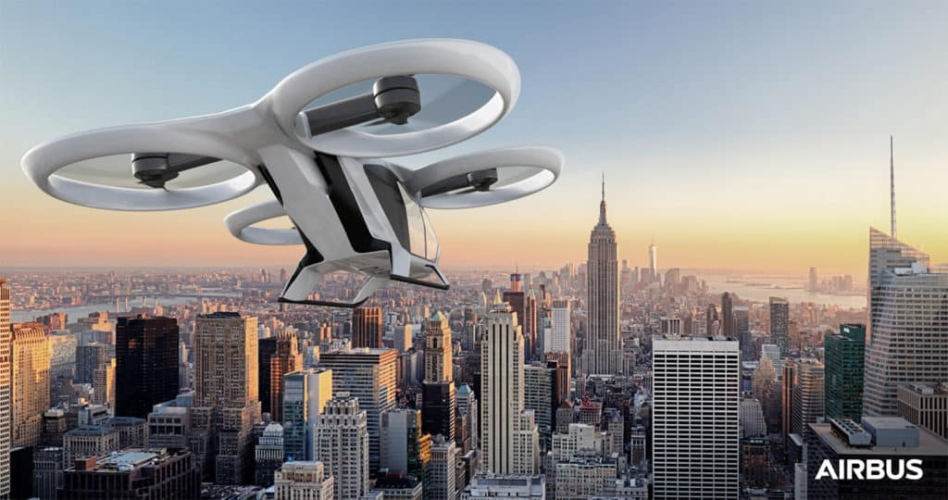
The future by Airbus
not so far from now…
Hi Darling, I just left the office, I’ll be home in 20 min, on time for dinner!
I’ll be polishing my Cranfield Manufacturing 2095 preparation over the flight so we can spend some family quality time!
OK, enjoy your commute!
Notes:
Urban mobility could also be Google or Uber concepts with autonomous, self-driving cars.
Time for self is key Figure of Merit of this future…

Slide 13
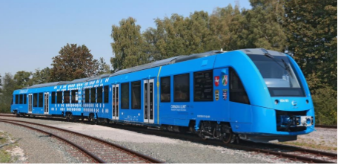
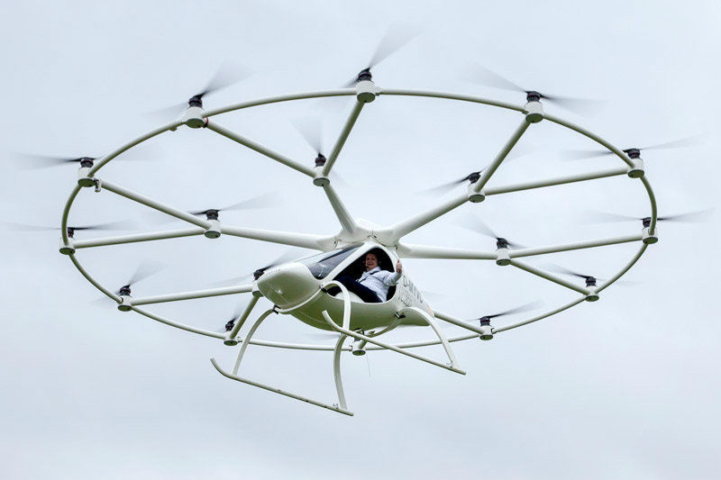
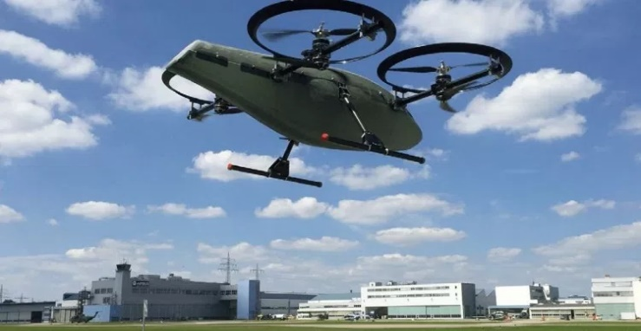
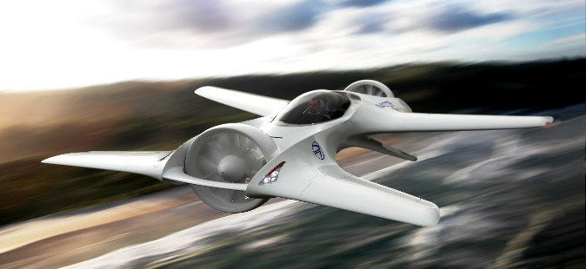
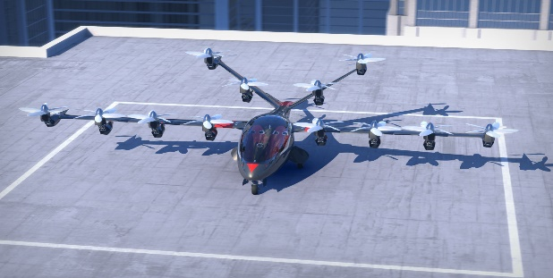

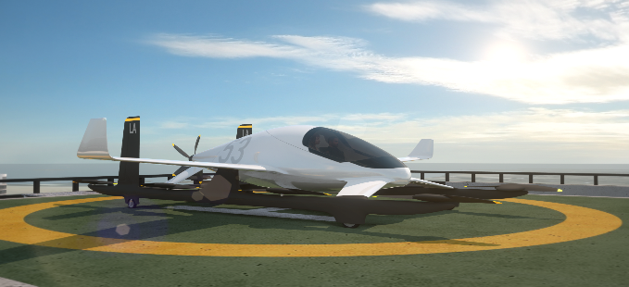
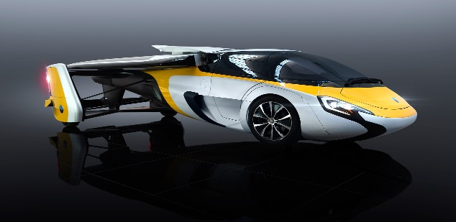
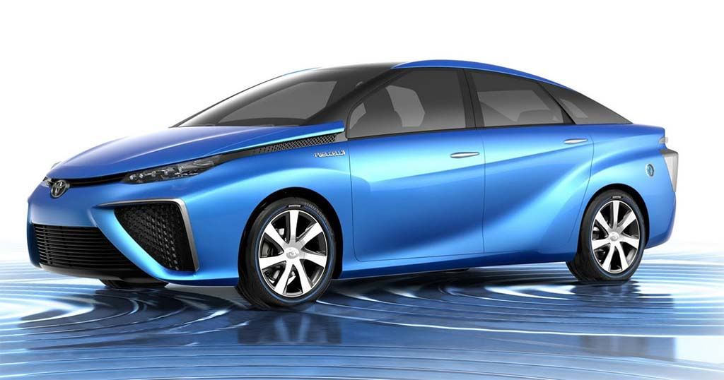
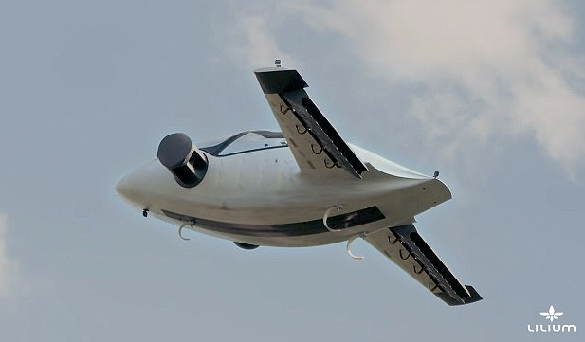
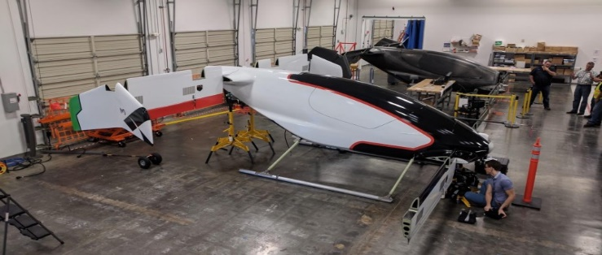
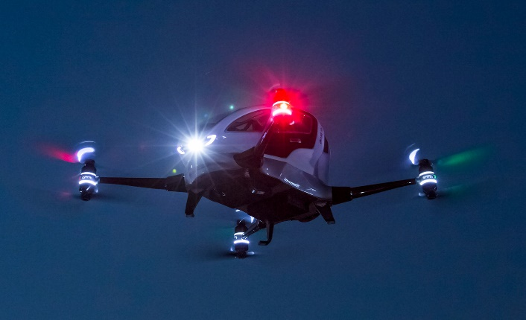
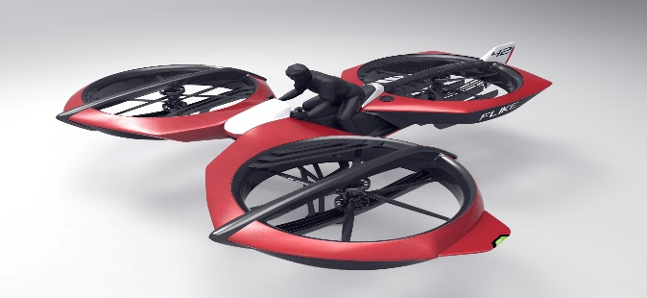
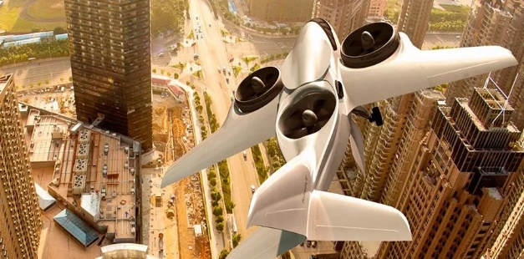
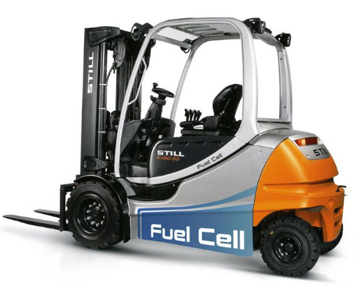
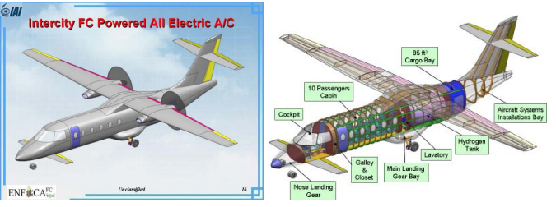
Electric transportation, futurology or reality?
Electric Mobility: an active landscape
Aerospace to set performance benchmarks
Technology, regulation and infrastructure challenges
Existing Urban Ground Mobility
Urban Air Mobility: Existing / under development platforms
UAM Projects
Delorean Aerospace DR-7
Joby S2
Volocopter
CityAirbus
Coralia iLint
Lilium jet
Airbus A^3 Vahana
Aurora eVTOL
Aeromobil
Toyota Mirai
Flike
XTI Aircraft Trifan 600
Ehang 184
IAI Small regional
Notes:
Is this the right path?
To which future this would lead us as a planet?

Slide 14

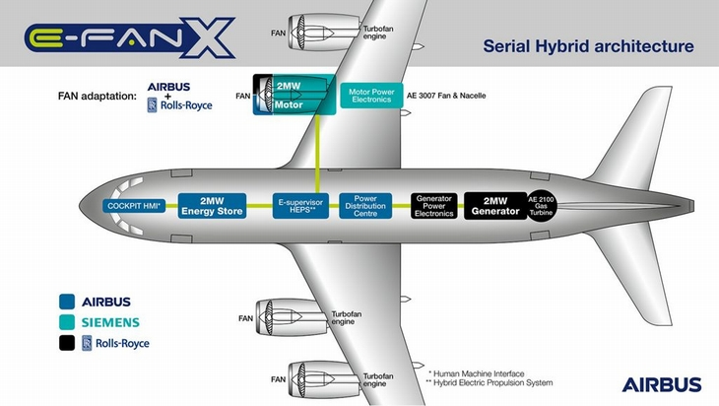
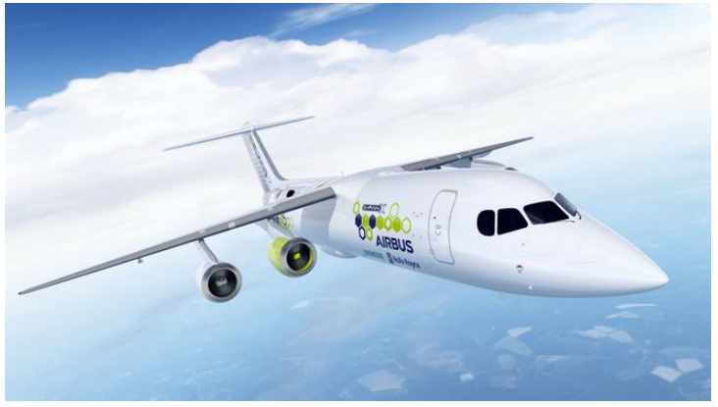
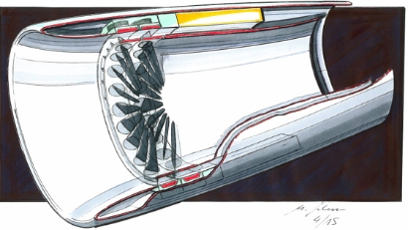
A progressive technology roadmap
2014: First flight of the e-Fan in July 2014, first fully battery-powered aircraft to cross the Channel
Nov 28 2017: Airbus, Siemens and Rolls-Royce team up for a major step towards reginal electrical aircraft: the E-Fan X hybrid-electric technology demonstrator is set to take flight in 2020
Step Objective: 2MW hybrid-electric power train
And so on until full electric propulsion…
Does this actually enable lower emissions for transportation?
M. Schumacher, Airbus
Notes:
LCC in aviation

Slide 15
Energy challenges for aviation
Why such a slow transition towards a cleaner future?

Slide 16

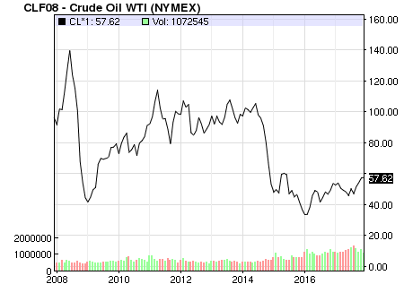
Energy challenges & game changers for energy
Energy transition challenges:
Technology & Operational challenges
Proliferation of energy sources
New mobility
Industry Fragmentation:
  stakeholders, cash-strapped govts → increase of investment risks
  Diminishing the power of scale to shape markets / local differentiation counts
  → agility takes precedence. More difficult to predict the future
  more difficult/risky to invest in projects
  Ironically, fragmentation is likely to encourage more partnerships & alliances to split costs & risks (e.g. O&G – Hydrogen Council)
Energy density (batteries)
Operations constraints (“refuelling”)
Thermal management
Infrastructures
Storage
Distribution
Green electricity generation
Market-pulled mobility path?
As trade enabler
No clear global industry roadmap to transition out of fossil fuels
Not pushed by low oil prices…
Notes:
MOBILITY PULL as TRADE ENABLER since 15th century
Oil trap:
Low prices
Plug-in hybrids
No clear willingness from all fossil fuel actors. If no carbon price is issued, market shall be the solution, driving business away of milking current situation.

Slide 17
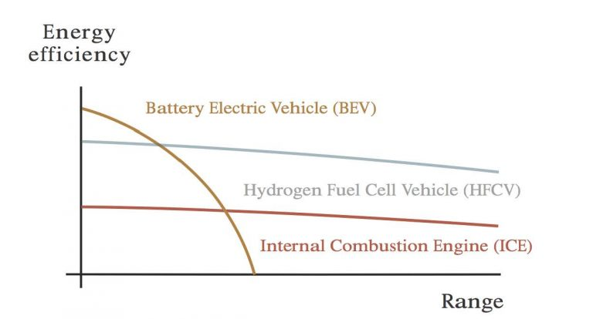
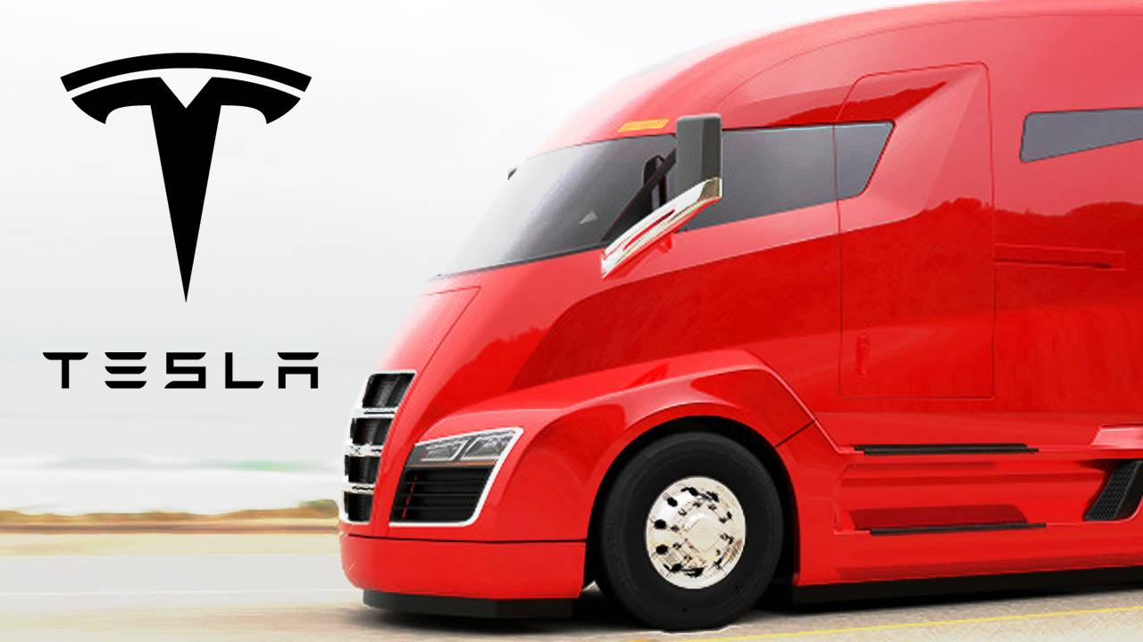
Pick the right battle
Making the right trade between Battery & Fuel Cell propulsion
Wrong question: batteries & fuel cells are for different use cases
(e.g. Urban Mobility for batteries and H2FC for longer ranges (road transport, etc.))
Considering the life cycle (emissions & costs), it all comes down to the initial source of energy
Relationship between energy efficiency and design range for different vehicle energy sources
Source: Rasa Riversimple
Need to increase share of renewables in Electricity generation, mainly in China, India and developing countries
95% of Hydrogen currently generated is done from fossil fuels
Emissions in manufacturing, uses of special metals implying mining emissions
Notes:
Continuous energy of Fuel Cell with 50-60% efficiency. Hydrogen is the energy carrier.
Vs.
Li Battery where fixed density – currently 280Wh/Kg.
“Color of electricity”

Slide 18
So… problem solved?
Let’s have a deeper look

Slide 19
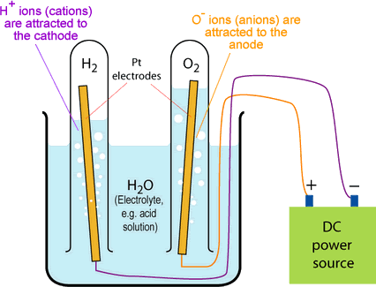
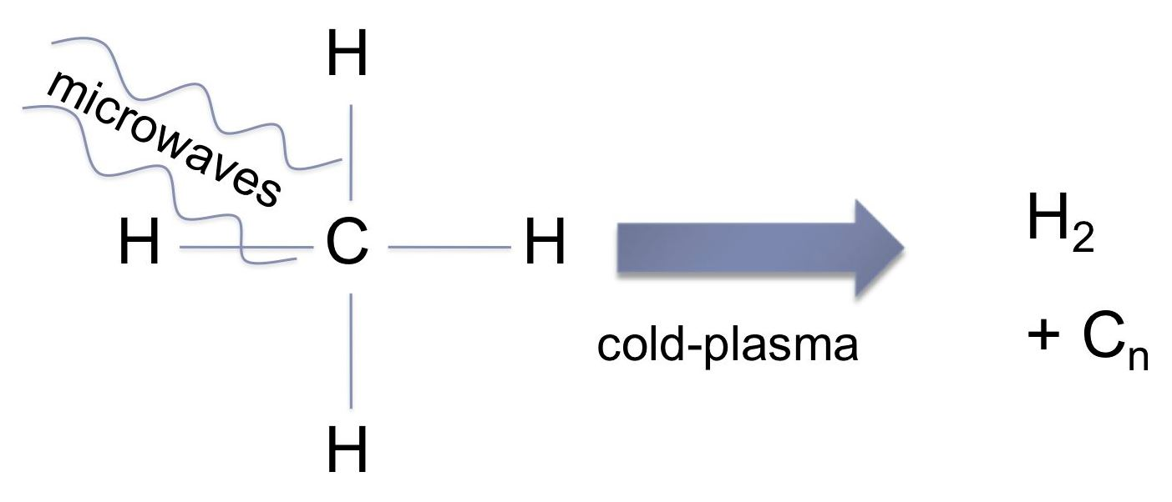
What physics tell us for Hydrogen generation?
Personal opinion expressed
Efficiency up to 90%
Efficiency 70-90% (under review)
1. Water electrolysis
2. Plasma cracking
Generates Hydrogen and high value carbon (e.g. nanocarbon, Graphene, CNTs)
Works also for CO2 cracking, generating O2 and C.
Generates Hydrogen and O2

Slide 20
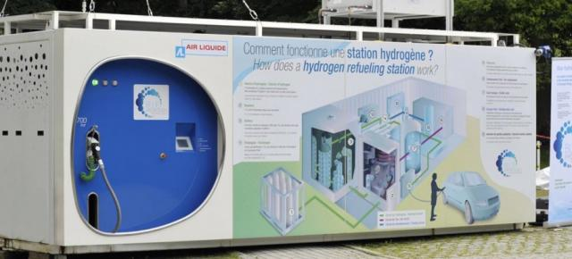
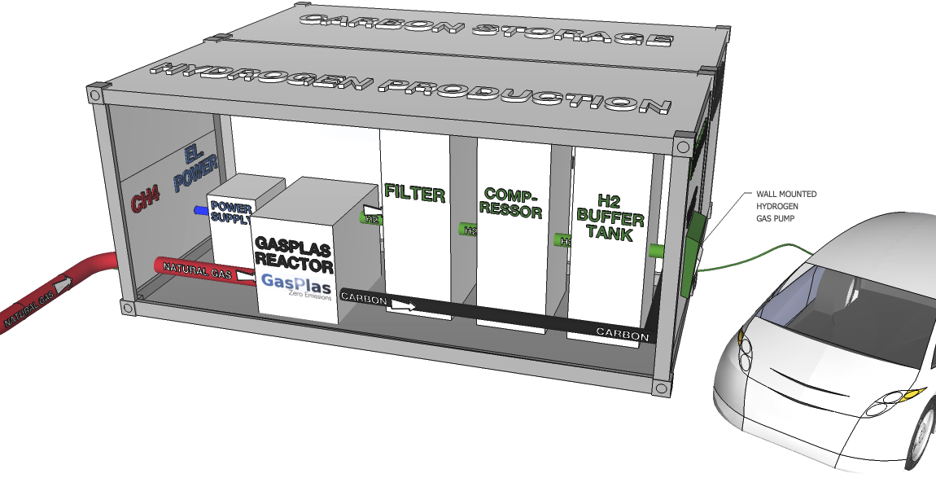
Highly scalable solutions
(whether centralized or distributed)
Distributed production disrupts logistics (reverse cartridge model of carbon to be re-inserted into industry)
Hydrogen refuelling station (experiment with Hype taxi fleet in Paris)
Previous challenges are being solved!
What about the value creation?
GasPlas solution (reaction 2)

Slide 21
New value streams beyond the hydrogen opportunity
Water Electrolysis
H2 + O2
H2 as energy vector
Energy from renewables
Methane or CO2 Plasma cracking
H2 + C
H2 as energy vector
Energy from renewables
≈90% efficiency
≈70% now target 90% efficiency
Water
Water
Water
Space, medical sectors, oxy-fuel combustion with full CO2 capture
High value carbon for industrial uses
Exponential impact
Beyond efficiency gains
New circular economics opportunities

Slide 22






Domino effect around hydrogen
Interrelations creating value loops across the board → lower barriers towards faster energy transition
Rocket fuel
O2
Medical use
Rocket fuel
Currently 95%
Fuell Cells → H20
Fossil source
Purified
water, H2O
Loss from transportation
Electrolysis process
Fertilizers
Water electrolysis
Electricity
H2
Renewable source
Energy storage
Electronics, cables, capacitors, batteries, etc.
Composites, Additive manufacturing
Improvement to Cement for construction
Electrical, Electronics
agriculture
Coatings
Other (permafrost, etc.)
Organic waste
Other (permafrost, etc.)
EM shielding
H2
Methane
H2
Methane
Functionalized composites
Fossil source
Fossil source
Plasma cracking
Plasma cracking
C (Graphene, CNT)
Methane Plasma cracking
C (Graphene, CNT)
Loss from transportation
Methane Plasma cracking
Electricity
Loss from transportation
Electricity
C (carbon black)
Composite fibers, Tyres, brakes
Renewable source
C (carbon black)
Renewable source
C02 Plasma cracking
CO2
C02 Plasma cracking
CCS
CO2
CCS
22
O2

Slide 23

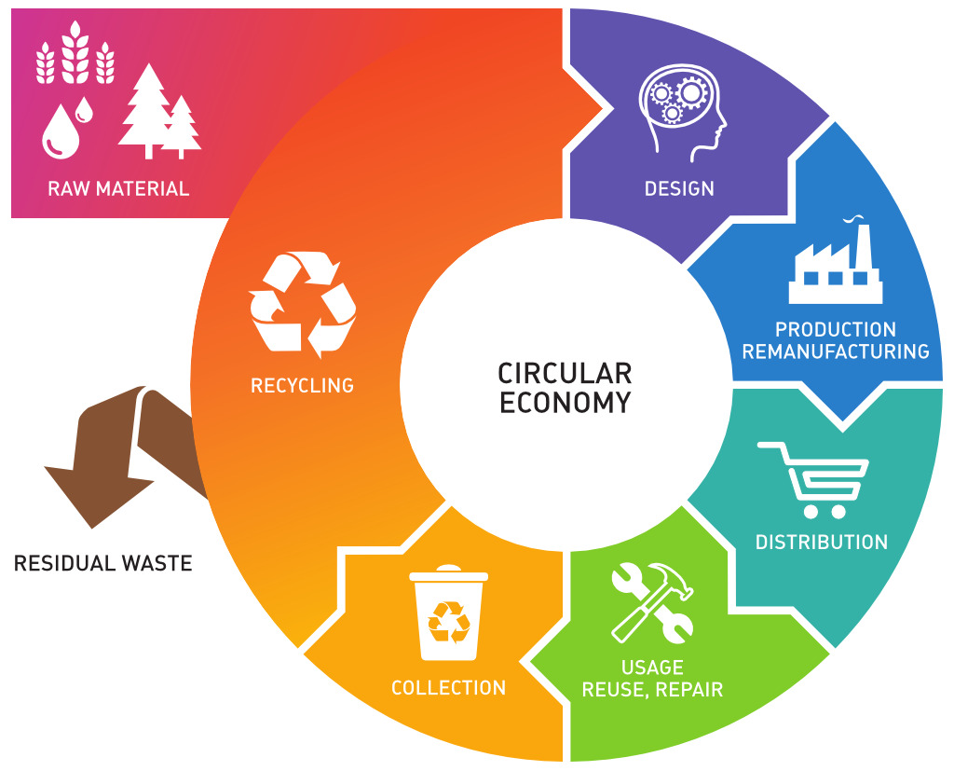


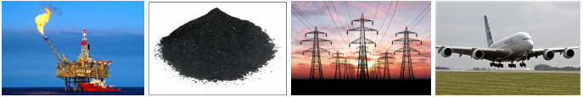

Strategic Alliances in a global
Green Circular Economy
Rocket fuel
Medical use
Value maximization
Agile, business driven
Rocket fuel
O2
Fuell Cells → H20
Fertilizers
Smart Carbon Alliance©
Demand drivers
Researchers
Implementers
Partners / Investors
Regulatory
Collaborative Information flow
Water electrolysis
Electrolysis process
H2
Energy storage
Electrical, Electronics
Coatings
EM shielding
H2
H2
Functionalized composites
Plasma cracking
Plasma cracking
C (Graphene, CNT)
Methane Plasma cracking
C (Graphene, CNT)
Methane Plasma cracking
C (carbon black)
Composite fibers, Tyres, brakes
C (carbon black)
Smart Carbon
C02 Plasma cracking
C02 Plasma cracking
Alliance
23
O2

Slide 24


Aligning and focusing strategic alliances for an « emicient » transition
Towards a carbon-efficient world
Regulatory & governments
Hydrogen Council
Smart Carbon Alliance
Watchdogs (IEA, IPCC, Carbon Tracker, study centers, etc.)
Not towards a « Low Carbon » at all costs, but rather a carbon-efficient economy
→ Ecosystems of transversal ecosystems and strategic alliances are key for a focused, agile and efficient transition towards a sustainable future across sectors
Multidsciplinary, cross-fertilization, holistic, open, collaborative and circular are key competences to be developped
Getting through the 4th Industrial Revolution (“4IR”) is only possible through collaboration and alliances, first and foremost to master the climate challenge as a catalyst towards the next IR
Notes:
EMISSION-EFFICIENT = EMICIENT
Dennis, Collburn & Lazar 2016
IEA?

Slide 25


Now that you start getting it…
Spread the word, challenge the idea, help define, coordinate and focus emicient actions to save the planet.
While enabling new sustainable, smart and circular business models for the post-climate crisis era.
This is Earth 2.0.
SMART
CARBON
(& HYDROGEN!)

Slide 26
Thank you

Slide 27
Back-up

Slide 28
The upcoming 5th Industrial Revolution
Interplanetary space inclusive
Next level on corporate emissions compliance, in a Smart Carbon economy
Circular materials economy
Bionic-AI human merge
Beyond robots
Shift towards a non-monetized system, where value is time

Slide 29
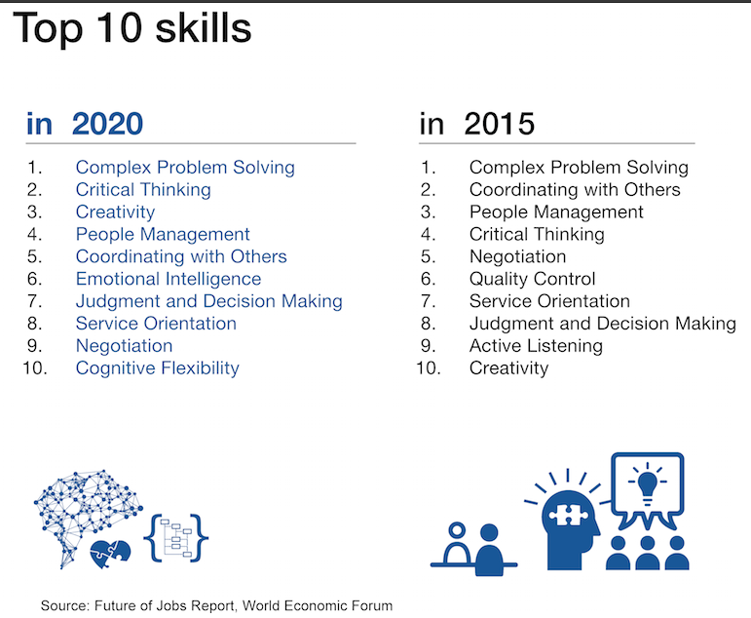

Slide 30
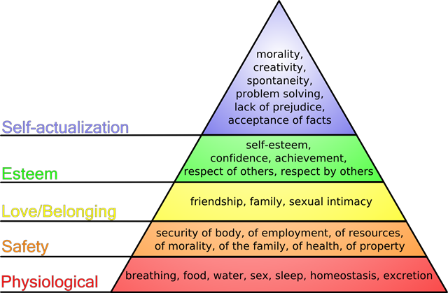
Sense or purpose → happiness

Slide 31
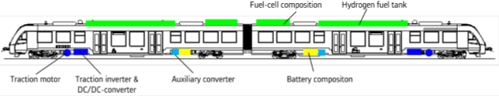
• The trains are powered by an electrical traction drive. Electrical energy is generated on-board in a fuel cell and intermediately stored in batteries.
• The fuel cell provides electrical energy by combining hydrogen stored in tanks on-board with oxygen from environmental air. The only exhaust is water steam and condensed water.
• The battery stores energy from fuel cell when not needed or from kinetic energy of the train during (electrical) braking and allows to support (boost) energy delivery during acceleration phases.
Coralia iLint

Slide 32
Towards a lower carbon aviation?
Only correct methodology: Life cycle emissions
Emissions life cycle for aviation is ≈90% during operations
Electric propulsion seems to be the ultimate solution to reduce in-operations emissions
Technology challenges:
Energy density
Operations constraints
Thermal management
Infrastructures
Storage
Distribtion
Green electricity generation
Notes:
Need for aviation to pave the way with a Life Cycle approach to ensure sustainable decarbon transition for transportation

Slide 33
Fuel Cells: a groundbreaking idea for electric propulsion
M. Schumacher, Airbus
The revolutionary idea is that the fuel cells’ direct current output is transferred directly to the motor coils thus driving the fan blades directly without heavy wiring, bus bars, converters, or batteries.
Notes:
Fuel cells generate electrical current by converting chemical energy to electrical energy, and – unlike batteries, which have a fixed supply of energy – can continuously provide energy as long as fuel is supplied. The only by-products of the chemical reaction are water and heat.
For aviation applications, hydrogen/air fuel cells could produce electric power in the 15-MW range that is necessary for commercial aircraft jet engines.
In these low temperature proton exchange membrane (PEM) fuel cells, hydrogen fuel is supplied to the fuel cell’s anode. In the anode, an electro-chemical reaction separates the hydrogen into negatively-charged electrons and positively-charged protons.
The electrons create an electrical current that is distributed through a circuit, while the protons travel through a substance called a proton exchange membrane (PEM), which blocks all electrons.
On the other side of the cell’s PEM is its cathode, where oxygen (air) is supplied to the system. The protons – arriving through the PEM – and electrons, returning from the electrical circuit, bond with the oxygen to form the cell’s two waste products: water (H2O) and heat. In aircraft, the fuel cells would be cooled by airflow through the electric engines.

